Slide 1

GLUCOSENSE PRO
Continuous Glucose Monitoring — A Clinical Introduction
Prepared for practice partners | T. Hlongwane

Slide 2


The Gap Fingerstick Testing Leaves Behind
Isolated Points
Blind Overnight
Targets Missed
A fingerstick captures glucose at one instant. It cannot show direction, speed of change, or what happened an hour ago.
Nocturnal and post-prandial excursions are the events patients and clinicians are most likely to miss entirely.
Roughly half of Type 2 Diabetes patients fail to reach HbA1c targets under standard point-in-time monitoring.
Continuous glucose monitoring closes this gap with a full trend line, not a snapshot.

Slide 3


The Device
A factory-calibrated CGM built to remove friction from daily monitoring.
GlucoSense Pro wears for 14 days, requires no fingerstick calibration, and measures interstitial glucose through a hair-thin filament roughly every minute — streaming continuous data with directional trend arrows to a paired app or reader.
14
DAYS PER SENSOR
14-day sensor wear, factory-calibrated — no fingerstick required
~1 min
Real-time trend arrows show rate-of-change, not just a point value
READING INTERVAL
Accuracy (MARD) of approximately 10%, in line with leading CGMs
~10% MARD
CLINICALLY ACCEPTABLE ACCURACY

Slide 4
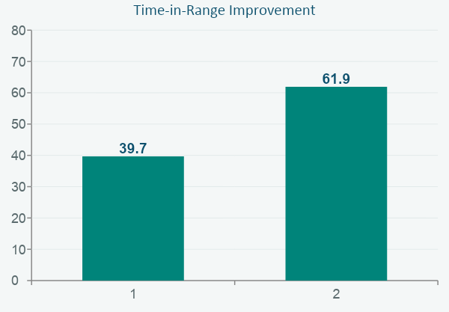

The Evidence
Primary-care Type 2 Diabetes population, non-intensive therapy, 3-month follow-up
−0.62% HbA1c reduction vs. matched controls (p<0.01)
CGM is recognised by the American Diabetes Association as standard of care for patients on multiple daily insulin injections or insulin pumps, with growing evidence supporting benefit in non-insulin-intensive Type 2 patients managed in primary care.
Notes:
Cite: primary-care T2D cohort, non-intensive therapy, 3-month HbA1c and TIR data. ADA position on CGM standard-of-care applies most directly to insulin-intensive patients.

Slide 5



Who It Fits
Primary Care
T2D patients on basal insulin or oral agents who are missing HbA1c targets under standard monitoring.
Endocrinology
T1D and insulin-pump patients — the population where CGM is already recognised as standard of care.
Diabetes Educators
The practical point of contact for onboarding, troubleshooting, and sustaining day-to-day patient use.

Slide 6
The Honest Line
CGM adds the most value for patients on insulin or with unstable control. For well-controlled patients on minimal therapy, standard monitoring may remain appropriate — we'd rather flag that plainly than oversell the indication.
Why we lead with this
Trust is the actual sales cycle in clinical settings — accurate framing earns repeat scripts.
A device recommended for the right patient is one clinicians keep prescribing.
Clear indications reduce early abandonment and protect long-term adoption.

Slide 7

Meeting the Objections Head-On
Five recurring clinician concerns, and the process behind each answer — full scripts available on request.
Will this get reimbursed?
Is the accuracy good enough to act on?
A point-of-prescription coverage check, plus bridging supply during approval.
~10% MARD, factory-calibrated, no fingerstick-dependent drift over 14 days.
My staff can't take on training.
Will patients keep using it?
One 20-minute session, then an in-app walkthrough handles most patient questions.
Structured first-two-weeks check-in drives materially higher continued-use rates.
We already use a competitor CGM.
Trial it on your next new script, run it alongside your current device, compare directly.

Slide 8
Start Small, Compare Directly
Trial GlucoSense Pro on your next eligible script. No panel switch required — just a direct, one-cycle comparison on accuracy and patient experience.
Prepared by T. Hlongwane

